Slide 1
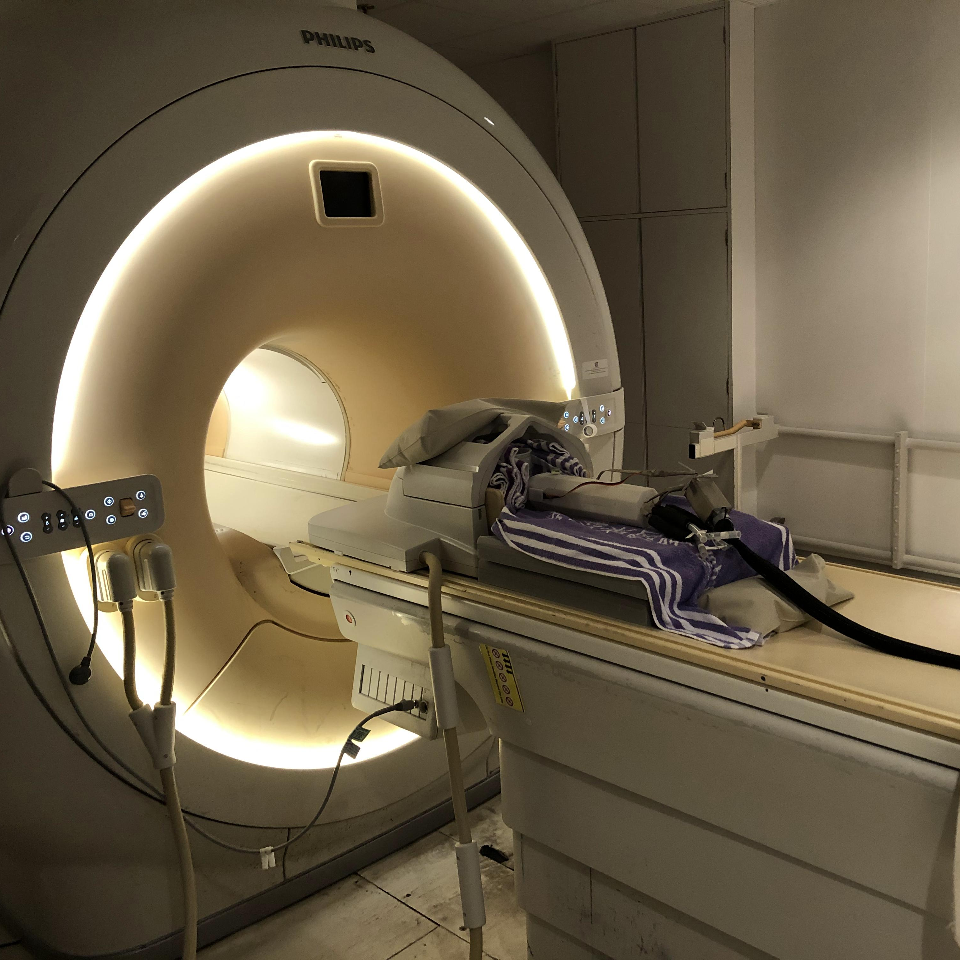
V0.2.1
64-bit (win64)
September 20, 2021
For internal test only
Neurosurgical Robot
Control Console
Configure, control and monitor for the MRI compatible neurosurgical robotic system.
Surgical Robotics and Devices Laboratory
CUHK

Slide 2
V0.2.1
64-bit (win64)
September 20, 2021
For internal test only
Neurosurgical Robot
Control Console
Configure, control and monitor for the MRI compatible neurosurgical robotic system.
Surgical Robotics and Devices Laboratory
CUHK

